Slide 1



Navyug vidhyabhavan Trust c.k.Pithawala college of engg. & tech. Computer department
Intern as web developer
Internship/Project
(3180701)
First Presentation
BE IV, Sem VIII
Presented By:
Zeel kaklotar
210090107505
Faculty Guide
PROF. Supriya Pati

Slide 2
Company Brief
Company Details
Technology Stack
Work Profile
Type of Engagement
Weekly Diary
Documents

Slide 3
Company brief
Our Vision :
We Are a Creative Digital Agency Based in India. Our Aim Is Provide Best Services and Knowledge to Every Client and Employee With Our Best Guidance.
Our Services :
Web Design and Development
Mobile Application development
E – Commerce Services
PHP Development
SEO(Search Engine Optimization)
Flutter Development

Slide 4
Company Details
Company Name : Leafdrive IT Solution
Address : 102,Swastik Chambers, Opp. Kailash Sweets,
Nr. Gokul Juice Center, Timaliyawad, Nanpura, Surat, Gujarat-395001
E-mail : info@leafdrive.com
Website/URL : leafdrive.com Mentor Name : Mihir Parmar
E-mail : mihirparmar123@gmail.com
Contact No. : 8866066301
Internship Duration in weeks : 2 weeks

Slide 5
Technology stack : web development
Full stack development is the process of designing, creating, testing, and deploying a complete web application from start to finish. It involves working with various technologies and tools, including front-end web development, back-end web development, and database development.

Slide 6
Full stack web develepment :
HTML
CSS
Javascript
Rest api
Ajax
Json
Mongodb
React js
Node js

Slide 7
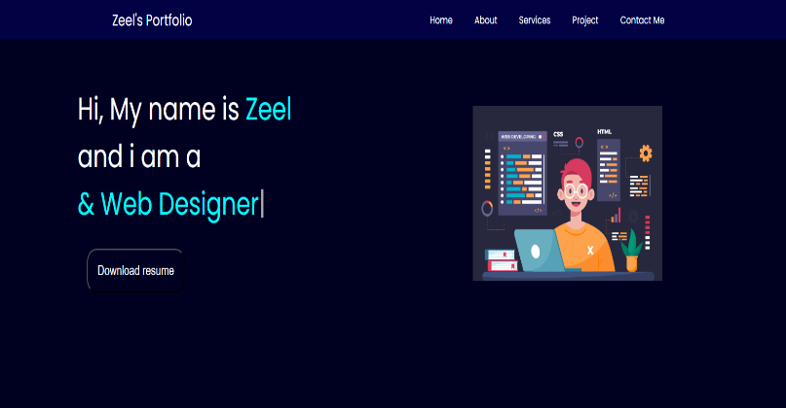
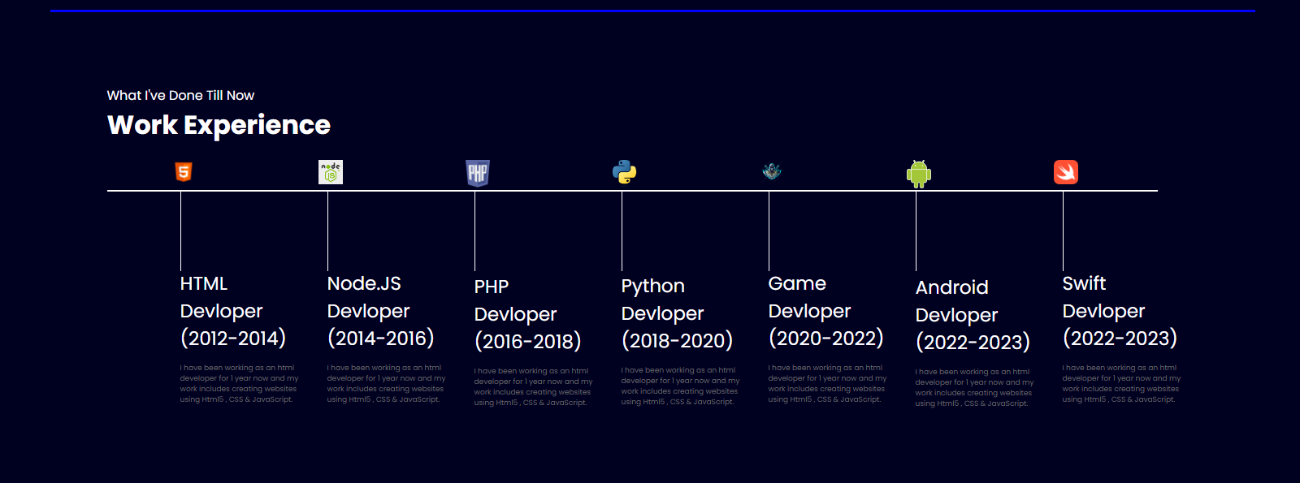

Work proﬁle:

Slide 8
Type of engagement:
Offline internship
Duration : 2 weeks 7 days in week

Slide 9
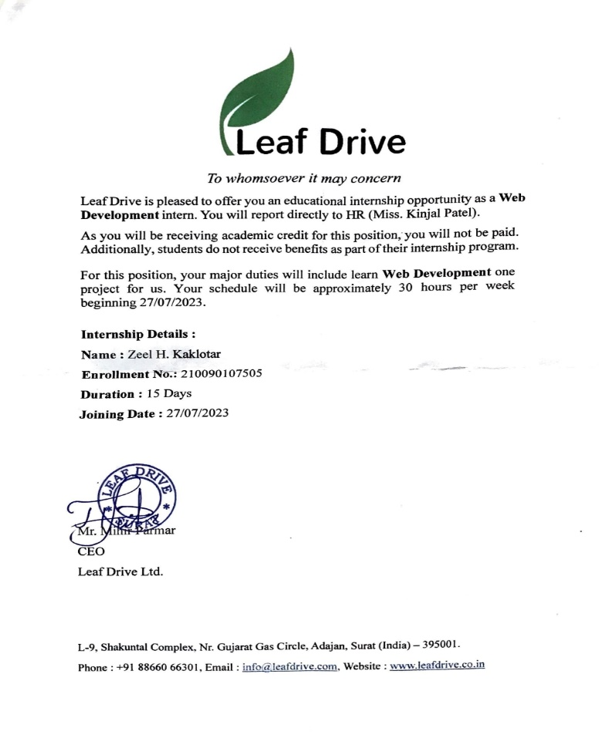
Documents :
Offer letter:

Slide 10
Weekly Details
Day (1-3): HTML Basics
Basics of HTML(tags, elements,
attributes).
Building a basic web page.
Creating Web page using HTML.
Day (4-7): CSS Basics
Understand CSS selectors, properties,
and values.
Styling the previous web page using CSS.
Learn about CSS Box Model(margin, padding,
border).

Slide 11
Day (8-10): JavaScript
Understand and utilization of JavaScript.
Day (11-13): SEO
Introduction to SEO.
Working of SEO.

Slide 12
THANK YOU….

